Slide 1

QHack | Hackathon
Self-driving car based on hybrid
quantum-classical neural networks
Team: DK02
Denis Katic
denis.katic@ait.ac.at

Slide 2
Introduction

Slide 3
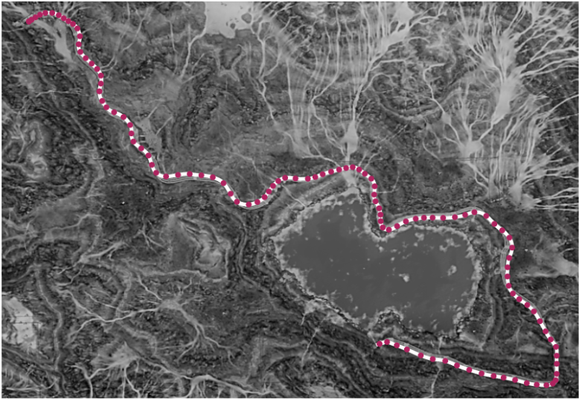
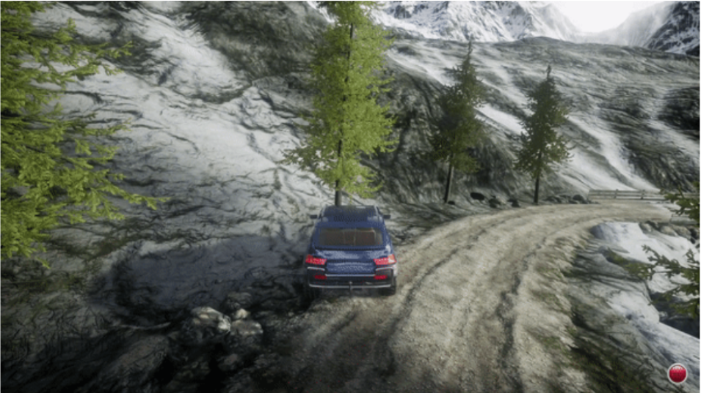
Introduction | Use case
Goal:
We want a self-driving car that can drive without human interaction
It should master the track without a car accident
Track

Slide 4
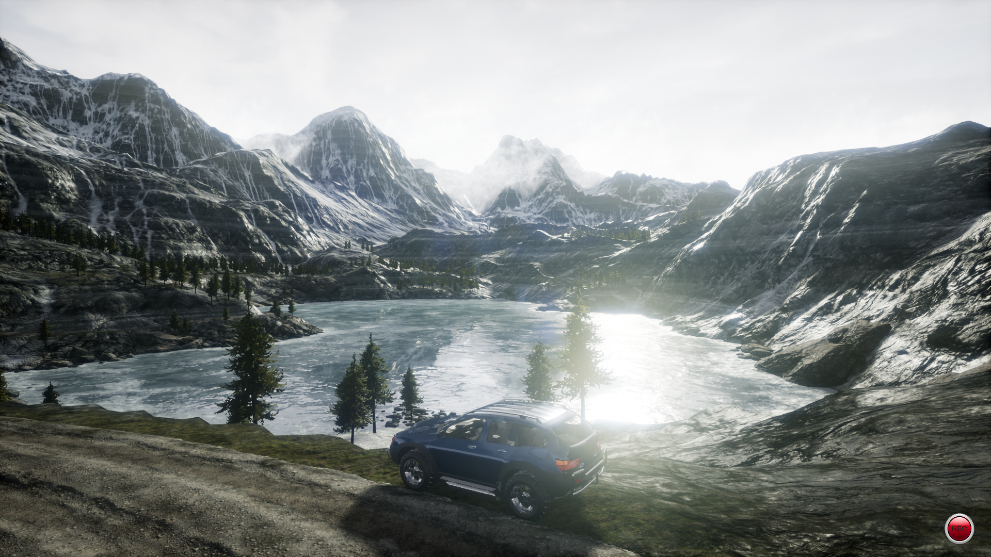
Introduction | Environment
The game is based on:
Unreal Engine
AirSim
Nvidia's end-to-end learning for
self-driving cars paper
Siemens / Austrian Institute of Technology
artificial intelligence workflow demo
including explainability
Code:
Pennylane
TensorFlow / Keras

Slide 5
Approach

Slide 6
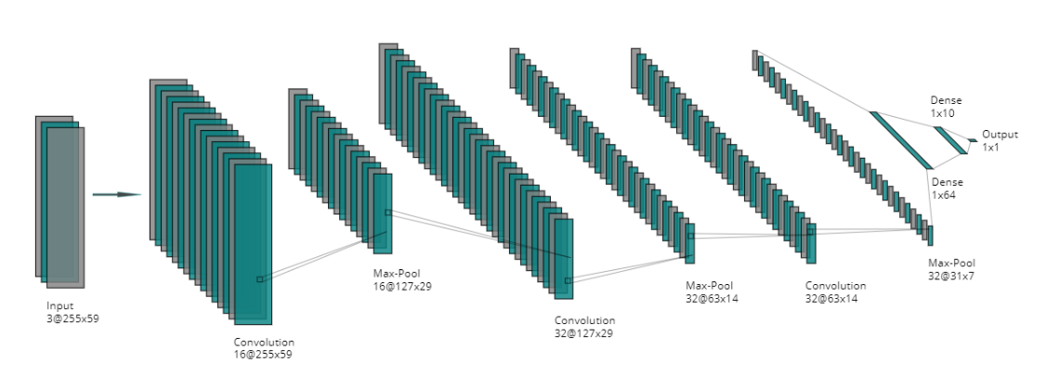
Approach | classical neural networks
Output: steering angle

Slide 7
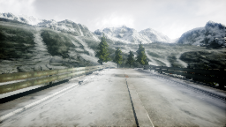
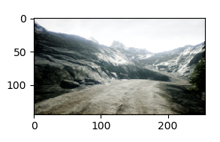
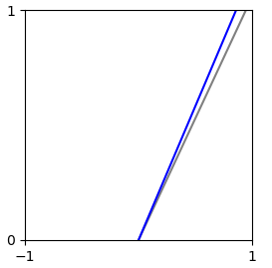
Approach | classical neural networks
train model based on 5624 images
Fix convolutional neural network (CNN) layer weights after training for transfer learning
Used as a benchmark model for comparison
Evaluation:
Test image
Steering angle
grey: user steering angle
blue: (AI) predicted steering angle

Slide 8
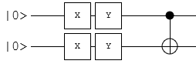
Approach | Hybrid Quantum-classical neural networks
This layer is replaced with a variation quantum circuit

Slide 9
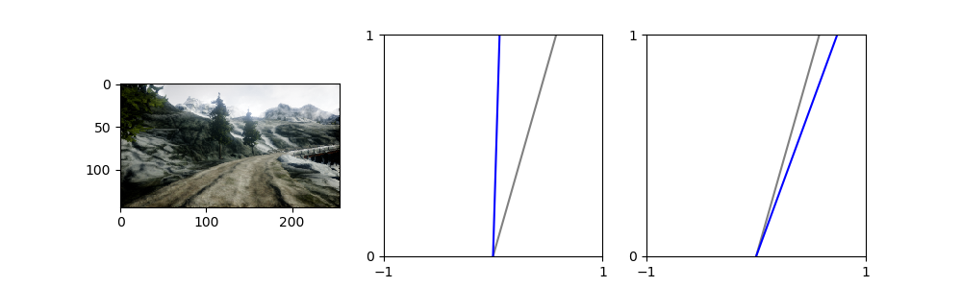
Approach | Hybrid Quantum-classical neural networks
6 different variational quantum circuits
different amount of qubits
Training
100 training epochs
Keras Adam optimizer
Keras loss function: mean squared error
each model architecture was created four times and trained on two different hardware
tested against 27 test images and compared with the classical model
Hybrid steering
Classic steering
grey: user steering angle
blue: (AI) predicted steering angle
Test example:
For more information about variational quantum circuits and variational quantum algorithms: https://arxiv.org/pdf/2012.09265.pdf

Slide 10
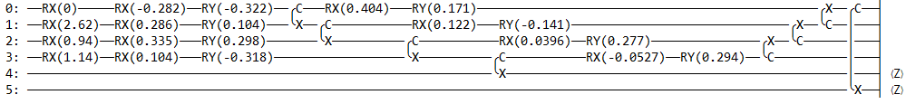
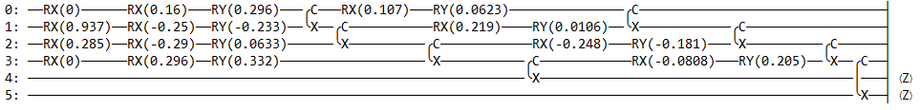
Approach | Hybrid Quantum-classical neural networks
quantum circuit type 1
Input: Pennylane AngleEmbedding function
Different to type 2
quantum circuit type 2

Slide 11
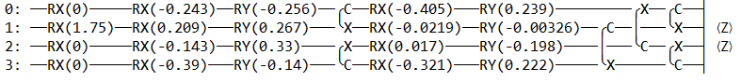
Approach | Hybrid Quantum-classical neural networks
quantum circuit type 3
Input: Pennylane AngleEmbedding function
quantum circuit type 4
Different to type 3

Slide 12
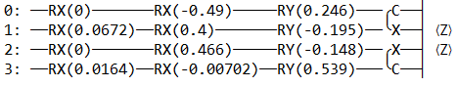
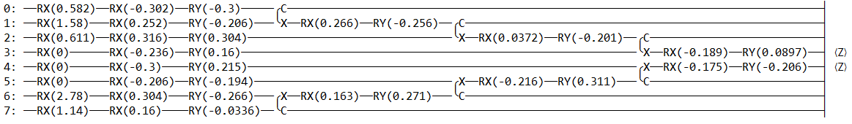
Approach | Hybrid Quantum-classical neural networks
quantum circuit type 5
Input: Pennylane AngleEmbedding function
quantum circuit type 6

Slide 13
Test Results

Slide 14
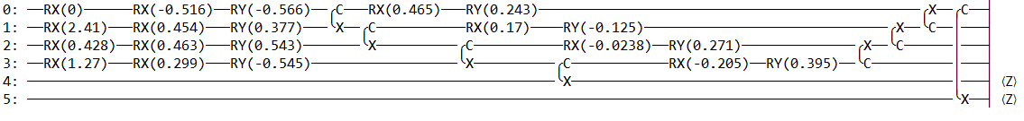
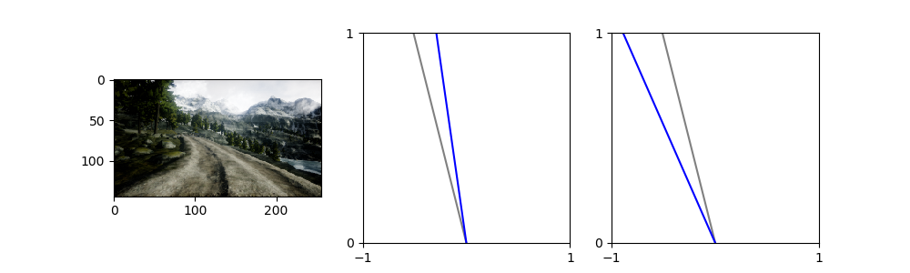
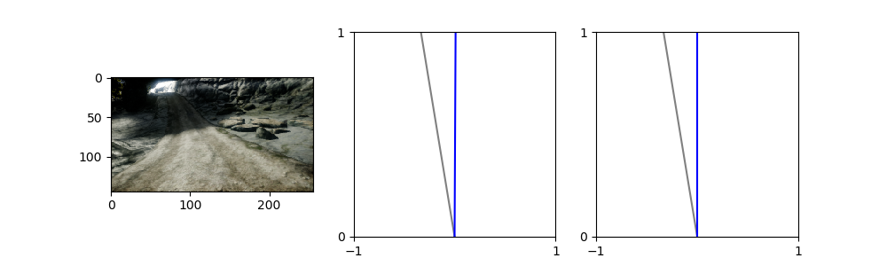
Result | Hybrid Quantum-classical neural networks
quantum circuit type 1
Hybrid steering
Classic steering
Hybrid steering
Classic steering
grey: user steering angle
blue: (AI) predicted steering angle

Slide 15
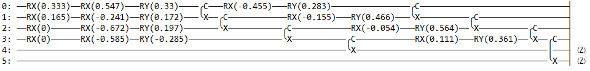



Result | Hybrid Quantum-classical neural networks
quantum circuit type 2
Hybrid steering
Classic steering
Hybrid steering
Classic steering
grey: user steering angle
blue: (AI) predicted steering angle

Slide 16
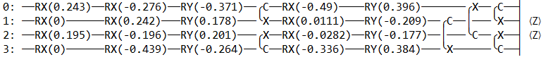
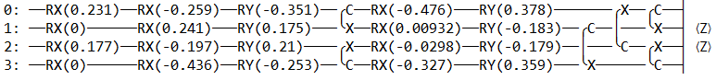



Result | Hybrid Quantum-classical neural networks
quantum circuit type 3
Epoch 100
Epoch 75
Hybrid steering
Classic steering
Hybrid steering
Classic steering
Model comparison based on epochs, as the simulation results are very different compared to the test results.
grey: user steering angle
blue: (AI) predicted steering angle

Slide 17



Result | Hybrid Quantum-classical neural networks
quantum circuit type 4
Hybrid steering
Classic steering
Hybrid steering
Classic steering
grey: user steering angle
blue: (AI) predicted steering angle

Slide 18
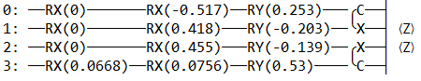
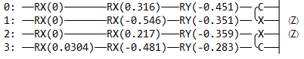



Result | Hybrid Quantum-classical neural networks
quantum circuit type 5
Hardware 1
Hardware 2
Hybrid steering
Classic steering
Hybrid steering
Classic steering
Model comparison based on different hardware, as the training data were randomly mixed and the simulation results are the same.
grey: user steering angle
blue: (AI) predicted steering angle

Slide 19
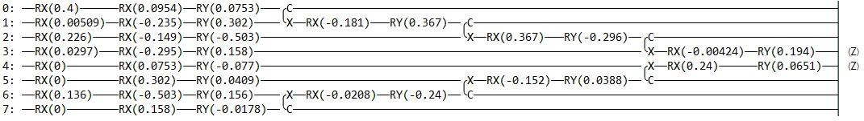



Result | Hybrid Quantum-classical neural networks
quantum circuit type 6
Hybrid steering
Classic steering
Hybrid steering
Classic steering
grey: user steering angle
blue: (AI) predicted steering angle

Slide 20
Result | Hybrid Quantum-classical neural networks
Test results
All 6 quantum circuit types show similar results
Open questions:
How much influence does a quantum circuit and it’s configuration have in a hybrid approach?
How big is the influence of the previously trained weights?
Would the models differ more if they had to be completely retrained without transfer learning?

Slide 21
Simulation Results

Slide 22
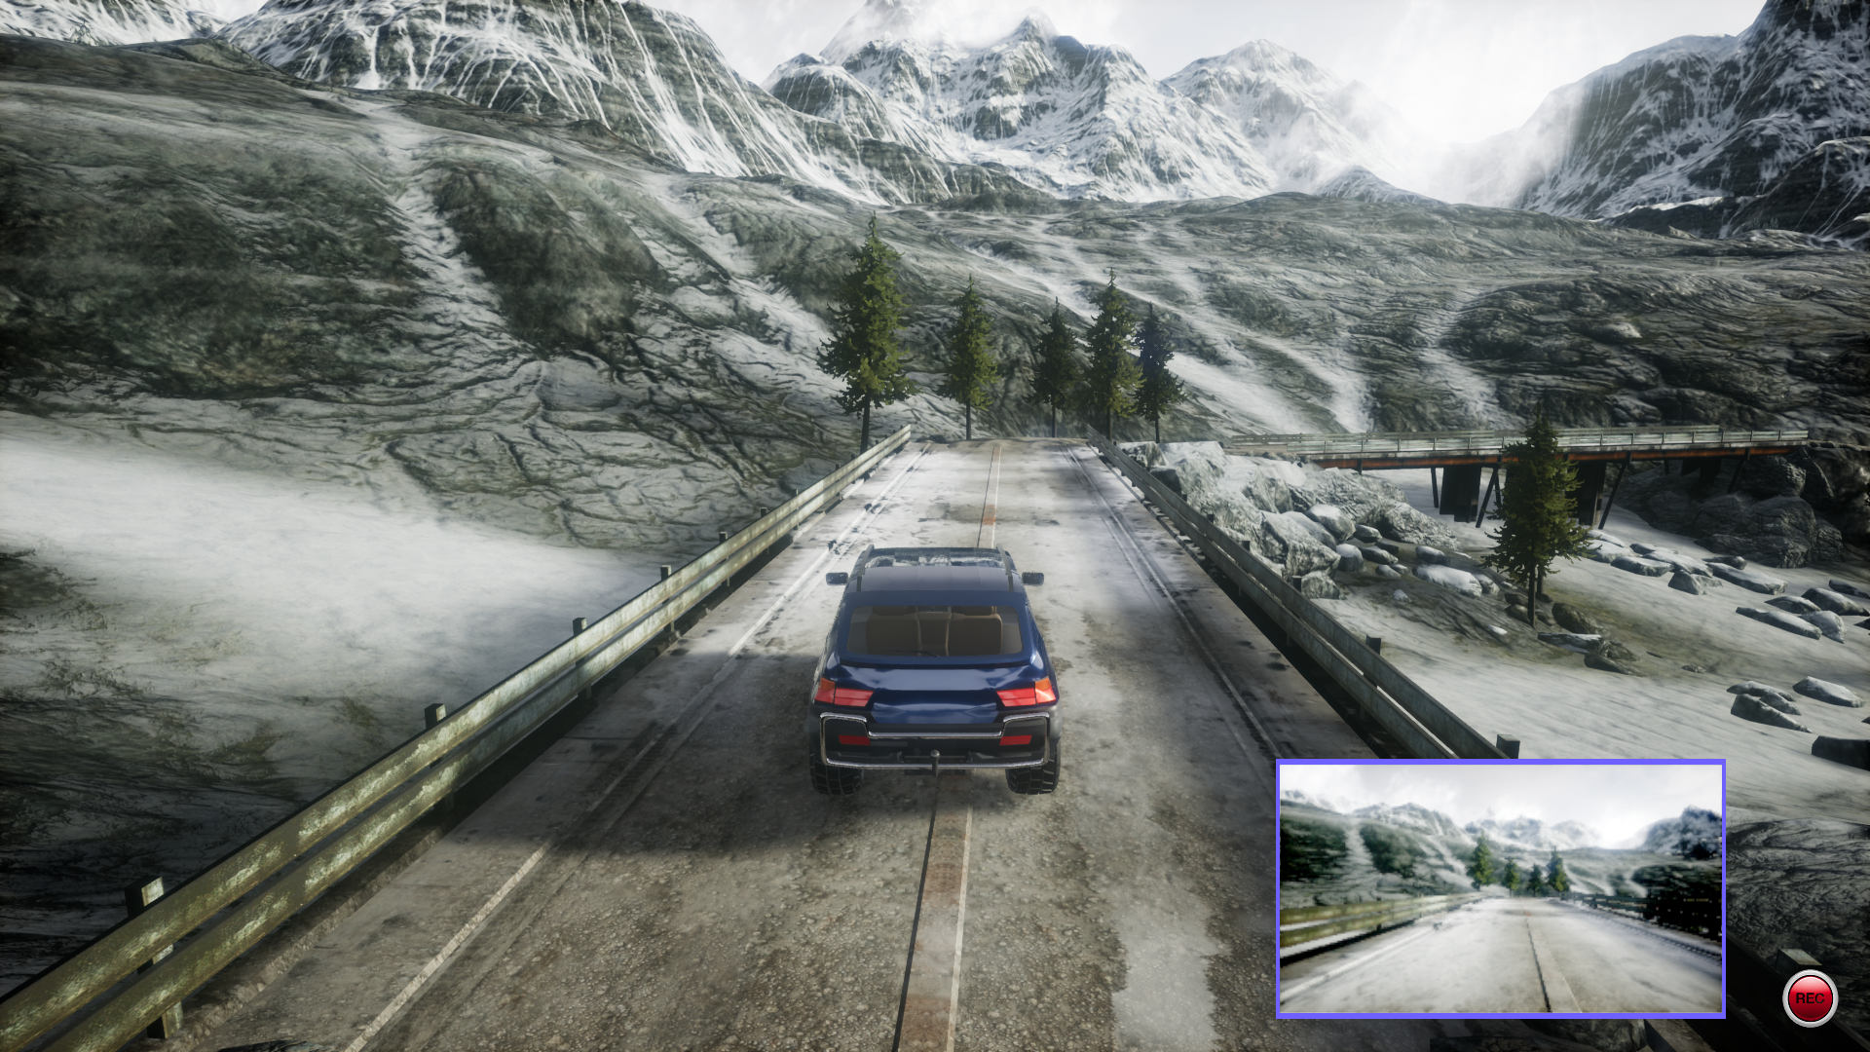
Result | Hybrid Quantum-classical neural networks
The best hybrid models were used to compete against each other on a track
If the car has an accident, the simulation will stop
This view is used for the prediction

Slide 23
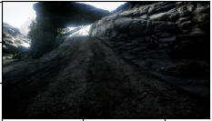
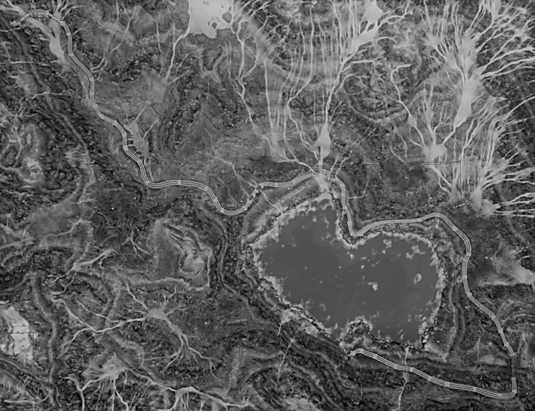
Result | Hybrid Quantum-classical neural networks
Shadow issue
Hybrid models
Type 1: epoch 86 – validation loss 0.0009381
Type 2: epoch 79 – validation loss 0.0010381
Type 3:
Epoch 75 – validation loss 0.0015353
Epoch 100 – validation loss 0.0011060
Type 4: epoch 94 – validation loss 0.0012984
Type 5:
Epoch 85 – validation loss 0.0006215
Epoch 94 – validation loss 0.0004812
Type 6: epoch 97 - validation loss 0.0006447

Slide 24
Result | Hybrid Quantum-classical neural networks
The best hybrid model:
Type 5 (epoch 94) model: https://github.com/DenisKatic/SelfDrivingQuantumHybrid/blob/main/documents/Quantum_hybrid_type_5_simulation.mp4

Slide 25
Result | Hybrid Quantum-classical neural networks
Results & Questions
Although the models had similar test results, the simulation results are different
A performance difference between type 1 and 2, although they have a similar circuit
Would further training epochs for complex quantum circuit models improve the results to such an extent that they would be comparable to type 5 models?
Do the complex models already have problems with the barren plateaus and can this be determined?

Slide 26
Thank You

